Slide 1
Course: Programming Fundamentals
4.00 Credit Hours, Fall 2015,
Graduate Program
Instructor: Maryam Ehsan
© www.uogsialkot.edu

Slide 2
Today’s lecture outline
Pointer fundamental
& operator
* operator
Pointer declaration
Pointer type

Slide 3

Simple variable declaration
Consider the declaration,
This declaration tells the C compiler to:
Reserve space in memory to hold the integer value
Associate the name i with this memory location
Store the value 3 at this location
Memory
Value at location
Location name
i
3
Location number or address
65520

Slide 4
Address – a class room example
1
2
3
4
1
Address of this chair
2nd row and 3rd column
2
(2, 3)
3
4
(5, 2)
5

Slide 5
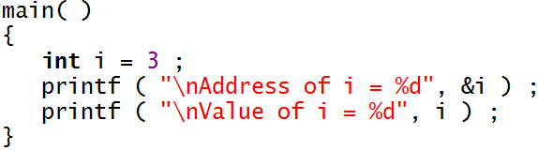
A program to print memory address
Output of program
Address of i = 65520
Value of i = 3
& used in this statement is C’s ‘address of’ operator

Slide 6


Cont.
Memory
Value at location
Location name
f
4.5
Location number or address
70020
ch
a
85690

Slide 7
* operator
The pointer operator available in C is *, called ‘value at address’ operator
It gives the value stored at a particular address
The ‘value at address’ operator is also called ‘indirection’ operator

Slide 8
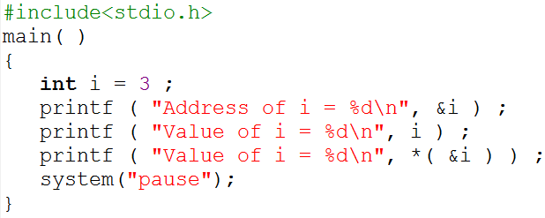
Example program
i
3
Program output
85065
Address of i = 85065
Value of i = 3
* (&i)
= *(85065)
= 3
Value of i = 3

Slide 9
Cont.
We can store the address of variable i in a variable say p, i.e.
p = &i;
p is not an ordinary variable
It is a special variable that contains address of other variable
Compiler also provide a space in memory for p like it do for other variables

Slide 10
Cont.
Memory
i
3
p = &i;
85065
p = 85065
p
85065
76950
i’s value is 3 and p’s value is i’s address

Slide 11
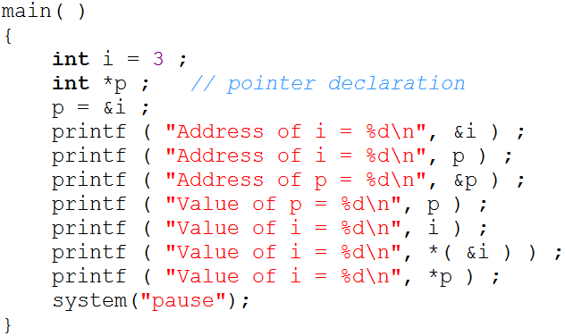
Pointer declaration
85065
85065
76950
85065
3
3
3
*(&i)
=*(85065)
= 3
*p
85065
i
3
*p
= *(85065)
= 3
76950
85065

Slide 12
Points to remember
Pointers are variables that contain a memory address as their value
In other words, a pointer variable contains a memory address that points to another variable
* operator means “value at address”
& operator means “address of”

Slide 13
Dereferencing a pointer
When you access the value that is present at the address hold by a pointer
*p
85065
i
3
76950
85065
*p = *p +10;
*p = *(85065) +10
*p = 3 + 10
*(85065) = 13
Pointer is Deferenced
*p
85065
i
13
76950
85065

Slide 14
Type of pointer
int *alpha ;
char *ch ;
float *s ;
alpha, ch and s are declared as pointer variables, i.e. variables capable of holding addresses

Slide 15
Cont.
Declaration float *s does not mean that s is going to contain a floating-point value
It means s is going to contain the address of a floating-point value
char *ch means that ch is going to contain the address of a char value

